Slide 1
Testcase data set of an MIS system with priority
Team Members:
Ramya Jagarlamudi – Z1948509
Rushith Kumar Challa – Z1948507

Slide 2
Abstract
The main goal of our project research question is about this dataset is based on software testing domain and is mainly used for prioritizing the testcases. In this project dataset we implemented some of the machine learning algorithms for prediction. After analysis it will be easy for testing based on priority.

Slide 3
Research Question?
Does R_Priority, weight, and complexity attributes play a role in determining the assigned testcases priority? Can we predict priority from these independent features using machine learning algorithms?

Slide 4
Motivation(Why?)
In Management Information Systems we will have different number of test cases while doing testing.
So because of more number of test cases we can’t find the priority of a particular case depends on high, low, medium.
So for easy way of understanding and finding the priority we took this type of dataset for better understanding.

Slide 5
Attributes
The dataset consists of some attributes. They are
B_Req --> Business Requirement.
R_Priority --> Requirement Priority of particular business requirement.
Weight--> assigning a weightage against Priority (Requirement Priority)
Time --> Estimated maximum time assigned to each Function Point of particular testing task.
Cost --> Calculated cost for each function point using complexity and time with function point estimation technique.
Priority --> Is the assigned testcases priority against each Function Point by the testing team.
Number of FP--> Function point of each testing task, which in our case are test cases against each requirement under covers a particular FP.
Complexity --> Complexity of a particular function point or related modules
FP --> Function point of each testing task, which in our case are test cases against each requirement under covers a particular FP

Slide 6
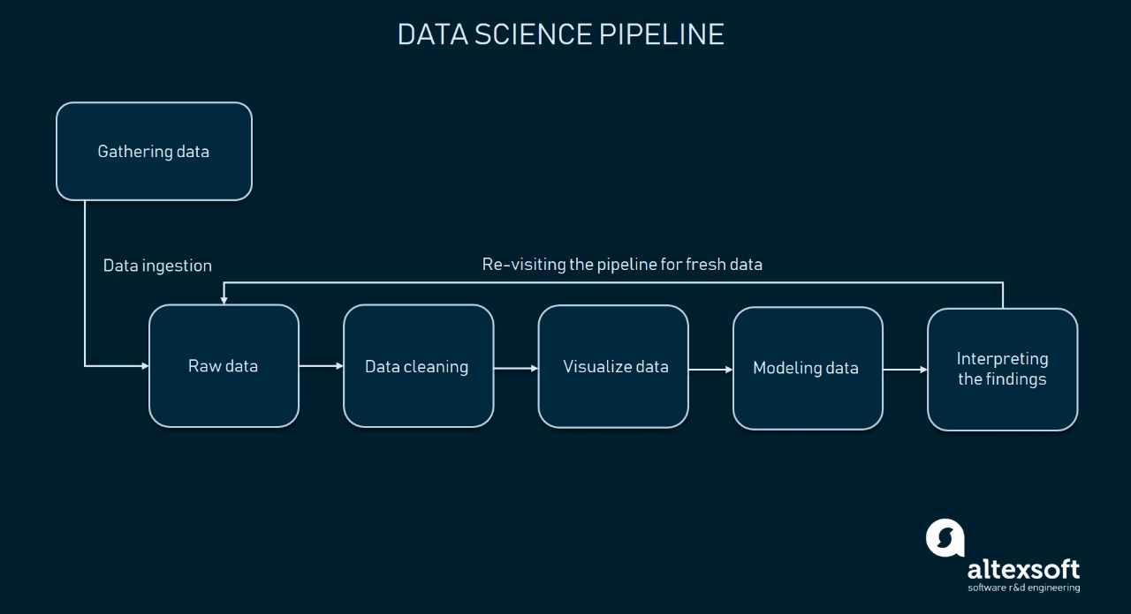

Slide 7
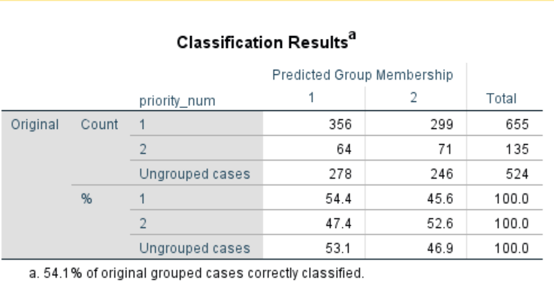
For this Testcase dataset of an MIS system we have done the first method is discriminant analysis in SPSS.
Based on the dependent and independent variables we can easily find the Box’s test for covariance matrix.
The accuracy for this system is 54.1% of original grouped cases.

Slide 8
Methods
After the discriminant analysis for the better understanding we go through some algorithms. They are
Decision Tree Classifier
Random Forest Classifier
Logistic Regression classifier.

Slide 9
Decision Tree Classifier
This is a one type of method in supervised machine learning which is used for classification and regression.
In this classifier we can find the precision, recall values and accuracy.
Decision Tree Classifier is a one type of algorithm in which the algorithm will be there in the form of a tree and it gives efficient output results.

Slide 10
Random Forest classifier
This is also one type of machine learning algorithm.
This algorithm is similar to decision tree classifier.
This algorithm can combine multiple classifications to solve complex problems.

Slide 11
Logistic Regression classifier results
Logistic Regression is a classification technique used in machine learning.
It uses a logistic function to model the dependent variable. Among all types of algorithms this is the one base algorithm.

Slide 12
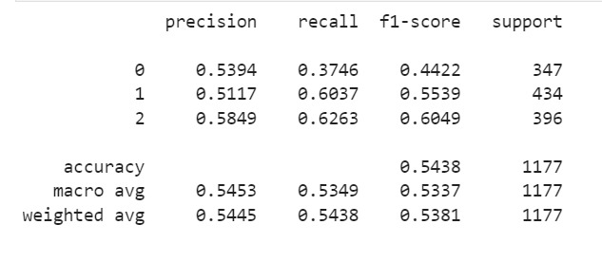
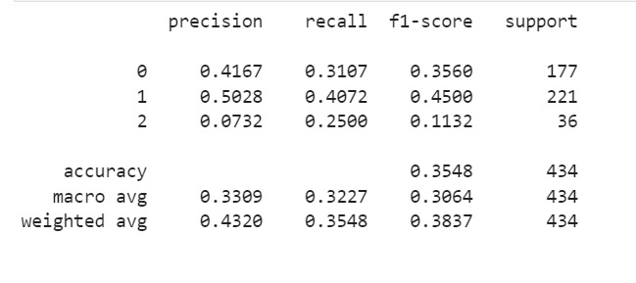
Decision tree classifier Results

Slide 13
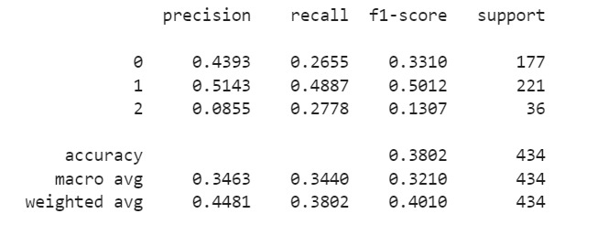
Random Forest classifier Results

Slide 14
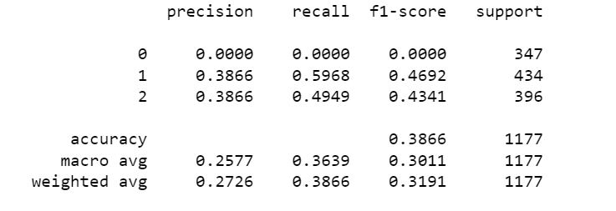
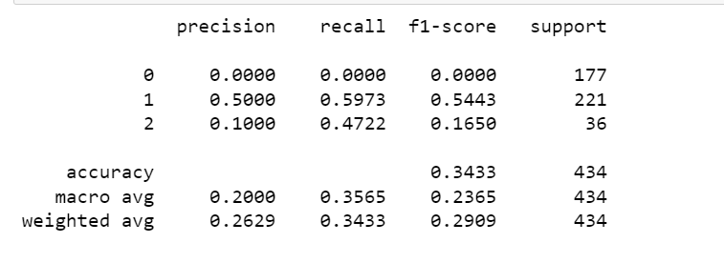
Logistic Regression classifier Results

Slide 15
Conclusion
We can apply more number of algorithms for the better accuracy of a testcase dataset which can be helpful for the further analysis. It Can be used reduce, select or automate testing based on priority, or cost and time or complexity and requirements. Can be used to build recommendation system problem related to software testing which helps software testing team to ease their task based on estimation and recommendation.

